Slide 1







Light of Tiny-bit
Breathing light
Yahboom

Slide 2









Contents
Preparation
Learning goal
Search for blocks
Combine blocks
Experimental phenomena
Yahboom

Slide 3

Preparation
1.The position of the LED lights and RGB Searching lights on the robot car
2.Learn about the principle of LED and RGB Searching light
Programming method:
Mode 1 online programming: First, we need to connect the micro:bit to the computer by USB cable. The computer will pop up a USB flash drive and click on the URL in the USB flash drive: http://microbit.org/ to enter the programming interface. Add the Yahboom package: https://github.com/YahboomTechnology/Tiny-bitLib to program.
Mode 2 offline programming: We need to open the offline programming software. After the installation is complete, enter the programming interface, click【New Project】, add Yahboom package: https://github.com/YahboomTechnology/Tiny-bitLib, you can program.
Yahboom

Slide 4
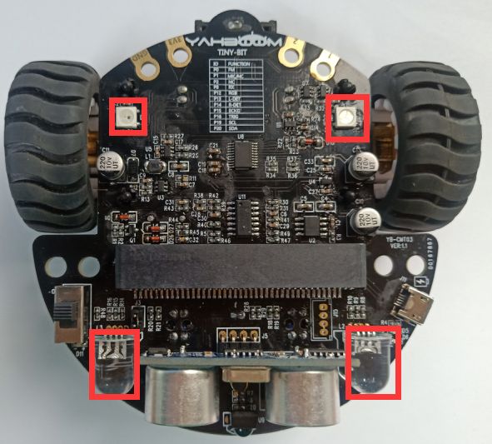
Preparation
In the picture shown below, the two lights by the red wire frame are the RGB Searching lights, the two white squares circled by the red wire frame are the colorful lights
Principle: LED light and RGB Searching light (red, green, blue) are packaged in the LED module. We can mix different colors(256*256*256) by controlling the brightness of the three LEDs.
Yahboom

Slide 5
Learning goal
1.Learn how to use RGB Searching lights and LED lights graphically program building blocks
2.In this lesson, we will realize breathing lights.
Yahboom

Slide 6

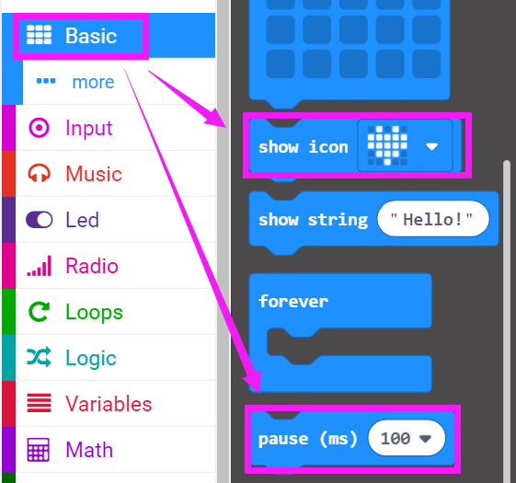
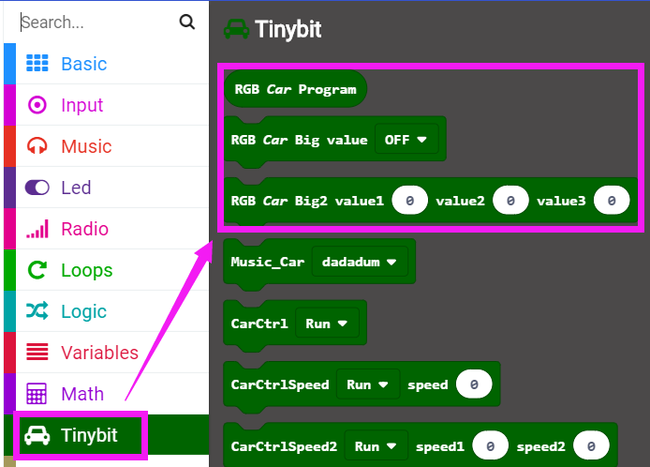
Search for block
The following is the location of the building blocks required for this programming.
Yahboom

Slide 7
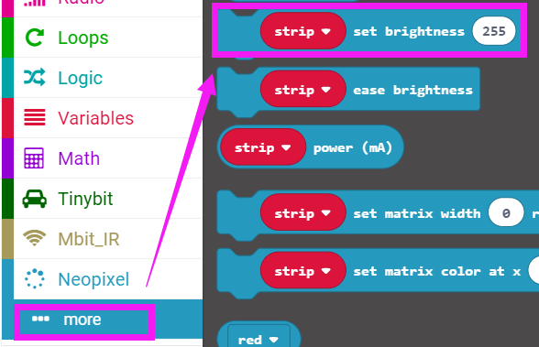
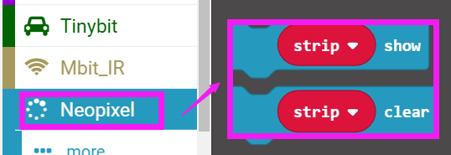
Search for block
Yahboom

Slide 8
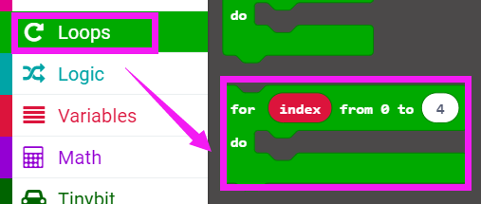
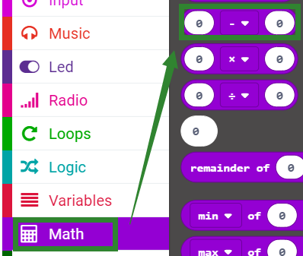
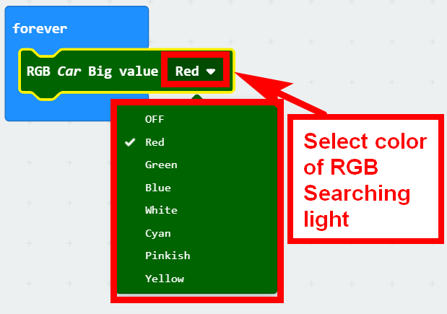
Search for block
Yahboom

Slide 9
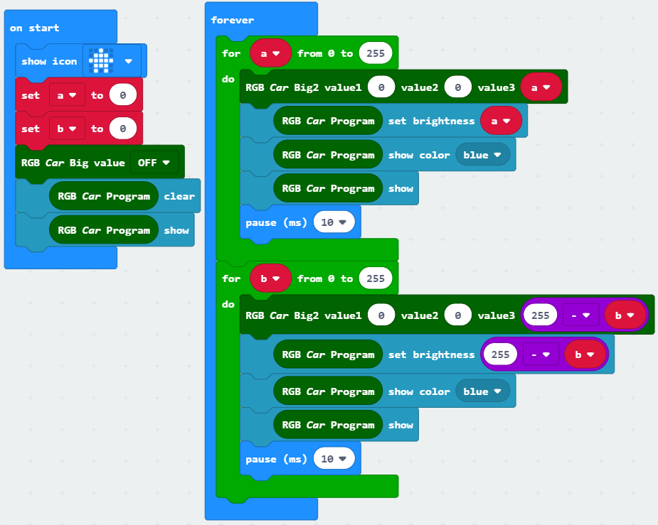
Combine block
The summary program is shown below:
Yahboom

Slide 10
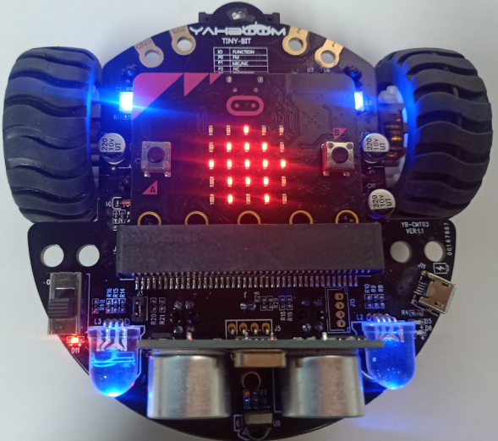
Experimental phenomena
After the program is downloaded, we can see that micro:bit board will display a house pattern on the dot matrix. All lights will realize breathing lights.
Yahboom

Slide 11
Inspire Creativity Embrace Innovation
Thank you!!!

